Slide 1
Face Detection and Tracking

Slide 2
Outline
To design and implement face detection and tracking using a webcam.
Required:
Implement the functionality using the OpenCV toolkit.
Program the project in C++.

Slide 3
Overview of the Development Process
Learn about the OpenCV toolkit (in Python).
Learn how to program in Python.
Implement face detection.
Learn how to apply concepts in C++.
Learn how to program in C++.
Implement tracking on top of detection.
Modify the program to detect and track multiple faces.

Slide 4
Learning OpenCV
OpenCV for Python Developers is an online course taught by Patrick W. Crawford, and can be accessed on Lynda.com. The course teaches several uses for OpenCV, which includes face detection and reading from a webcam. Some other concepts taught in the tutorial

Slide 5
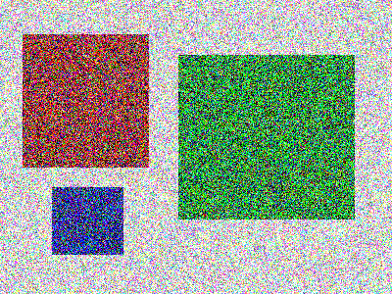
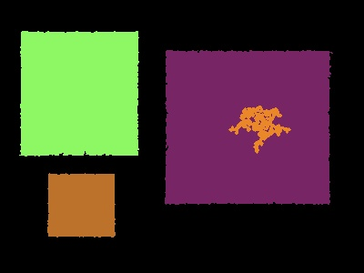
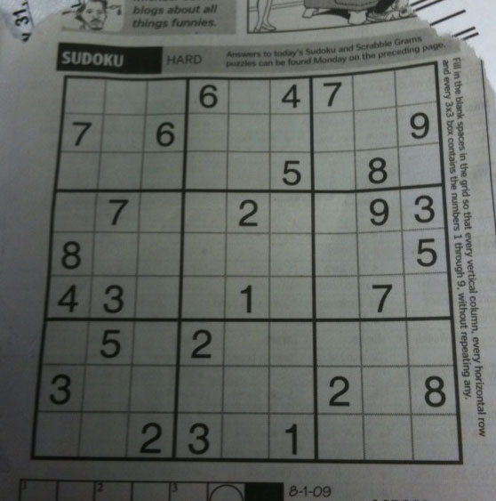
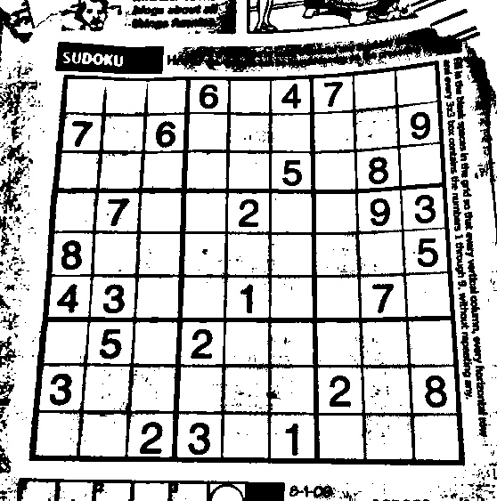
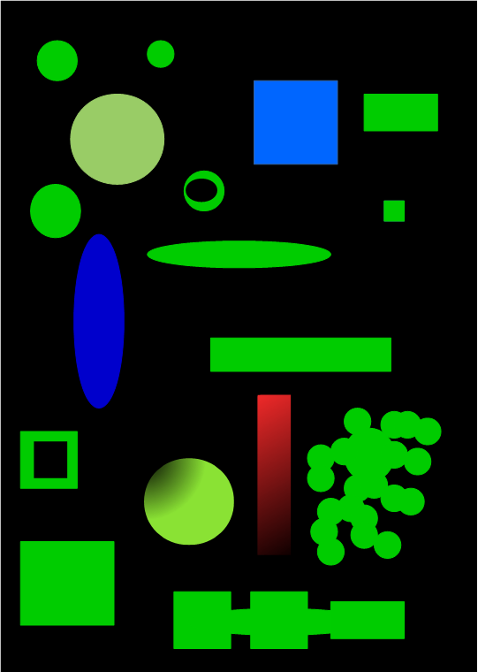
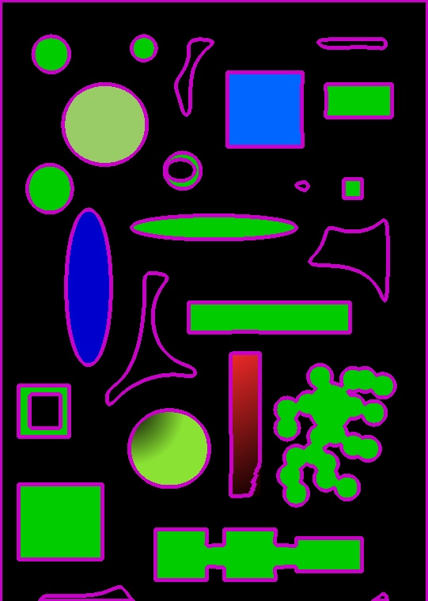
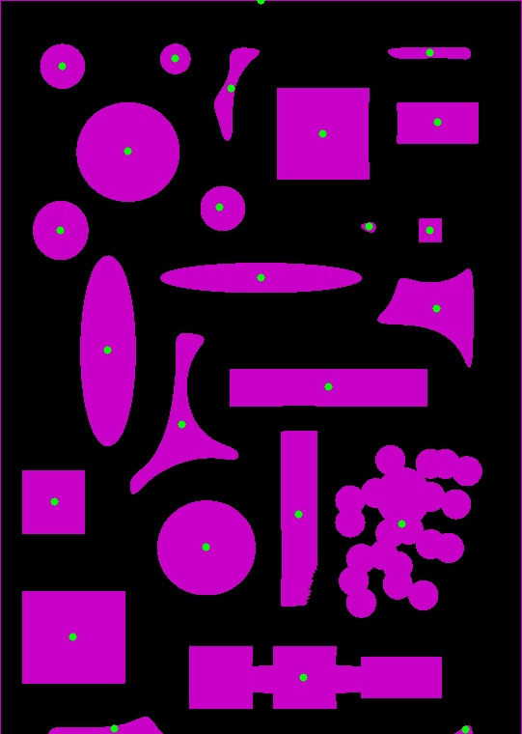
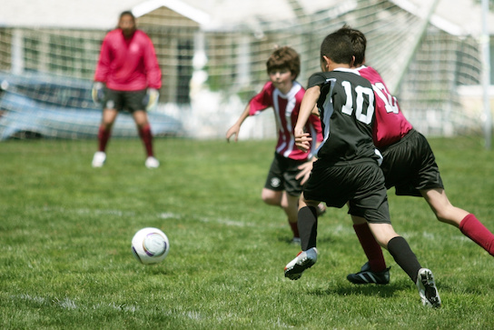
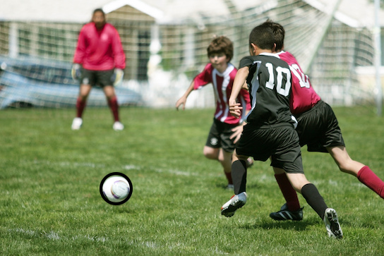
Examples of Concepts Learned
Object Detection
Adaptive Thresholds
Object Contouring & Center points
Template Matching

Slide 6

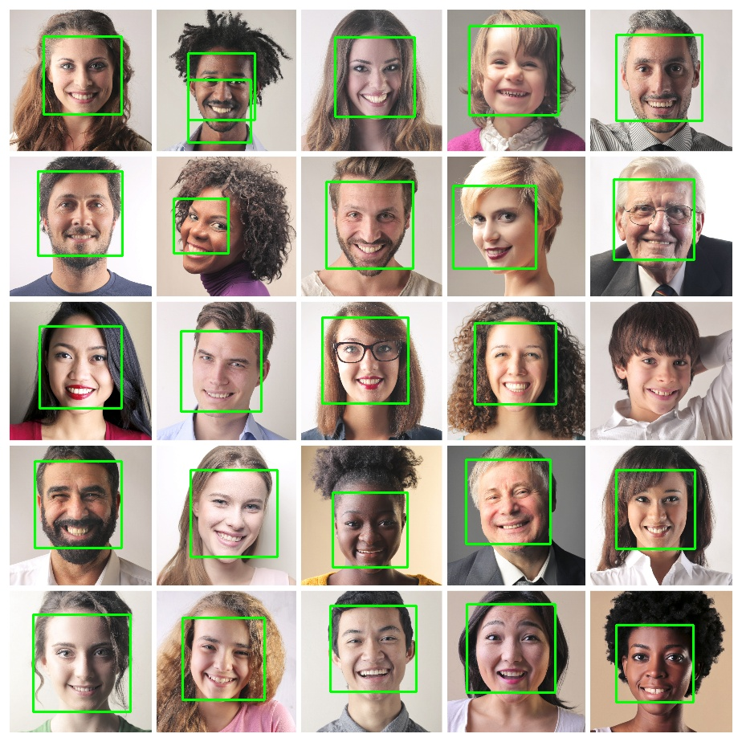

Face Detection
While following the tutorial, face detection is taught using the harr cascade method. This requires a file that helps detect patterns. The particular file used is designed to detect faces, but there are plenty of others to detect various objects.

Slide 7
Face Detection (Cont.)
Once I completed the tutorial, I created a python program to detect faces using a webcam for input. This was done by modifying the detection program to read frames from the webcam (Taught in lesson 2 section 8) instead of an image.

Slide 8
Applying Concepts in C++
In order to program in C++ using the OpenCV toolkit, the environment has to be created.
This is done using Visual Studio, Cmake and the respective OpenCV files.
I then learned the syntax of C++, and translated the Python version of my program.

Slide 9
Tracking
The program at this point it designed to run face detection every frame, without tracking from the previous frame. This in inefficient, and much slower then tracking an already tracked object.
As tracking was another new concept, I looked for ways on how to implement it.
I used a program that is designed to track an object from a video as a frame of reference.

Slide 10
Final Steps
The program at this point was capable of tracking one face at a time. In order to track multiple, I had to solve several issues:
Prevent a face from being detected if it was currently being tracked.
Prevent some performance loss with regards to running the detection method.
Come up with a solution to differentiate between trackers.
Allow a tracker to be lost without effecting the other trackers.

Slide 11
Prevent Duplicate Detection
To prevent duplicate detections of the same face, I checked the center-point of newly detected with the rectangle of faces being tracked. If the center-point is found to be within the detected faces bounding box, we assume the face is a duplicate and ignore it.

Slide 12
Detection efficiency
The program is now capable of keeping track of a face from a previously detected frame. The problem however is that the face is getting redetected then ignored because the detection method is running every loop. This results in the tracker losing its main purpose – to improve performance.
To improve performance the detection call was modified to run on a set interval of frames. The result is a smoother user experience, as the performance loss is greatly reduced.

Slide 13
Differentiate Between Trackers
I felt that knowing the difference between two trackers was an important feature. It makes the tracker easier to follow among other trackers, and can signify when a tracker is lost. (For instance, when a face moves too quickly between frames and is lost then redetected).
To achieve this I chose to apply a random colour for each new tracker.

Slide 14
Tracker Independency
In order to implement independency I used a structure that allowed objects to be removed freely. I chose to implement this with vectors of a new class.
Vectors allow the “list” to add and remove elements, as they can be a “list” of varying size.
Defining my own class allows for information pertaining to a tracker to be organized more easily.
The class contains:
The rectangle around the face
The tracker object to update the position
The colour of the rectangle when drawn

Slide 15
Summary
While designing the program to detect and track faces I learned several valuable key concepts:
How to program in Python and C++.
How to do various tasks using OpenCV.
Better my skills of overcoming programming problems.

